Slide 1

ScanMasterX Team No 10: UwUltimate Stardust Crusaders

Slide 2
Team Details
Headshots with Names

Slide 3
Project Overview
Spend one minute describing the need
What’s the main goal of the project
This lays the foundation and motivation for everything else you’ll be presenting
You don’t have time for discussing all of the requirements, but you can mention two or three of the functional and non-functional requirements for the project

Slide 4
Requirements List
R1:………….
R2:……….
(Please Be concise)

Slide 5
Project Solution Approach
What are the major components in your solution design?
Is it a web framework?
Is it a mobile application?
Having next slide be an image/drawing of your structure would be great
What are the tools, frameworks, platforms, libraries, etc. that you’ll be using
Note one or two that are key to your solution
Is there any key reason why you’re using a given technology?
There’s not a long time here to do compare and contrast, but a few key words about why you picked the system that you did will be appreciated

Slide 6
System Architecture Diagram

Slide 7
Use Case Modeling

Slide 8
Structural Modeling: Class Diagram

Slide 9
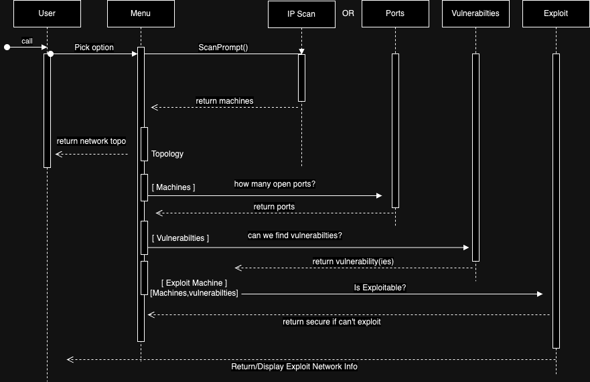
Behavioral Modeling: Sequence Diagram

Slide 10
Behavioral Modeling: Activity Diagram

Slide 11
Screenshots (UI, Code, if any)

Slide 12
What Next??

